Slide 1

Standing on the beach, how far can you see off-shore?
Answer: ≈ ____ nautical miles

Slide 2
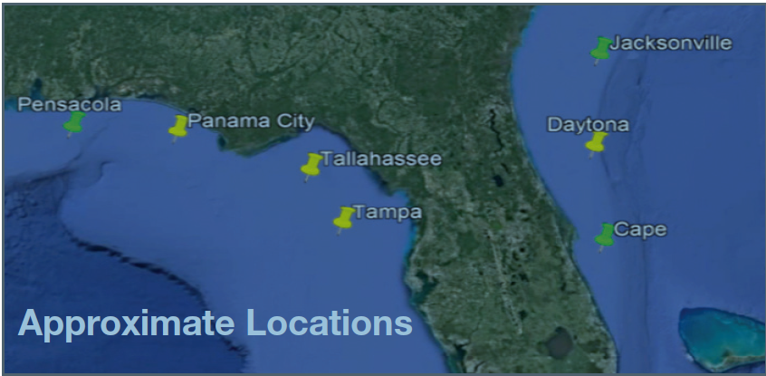
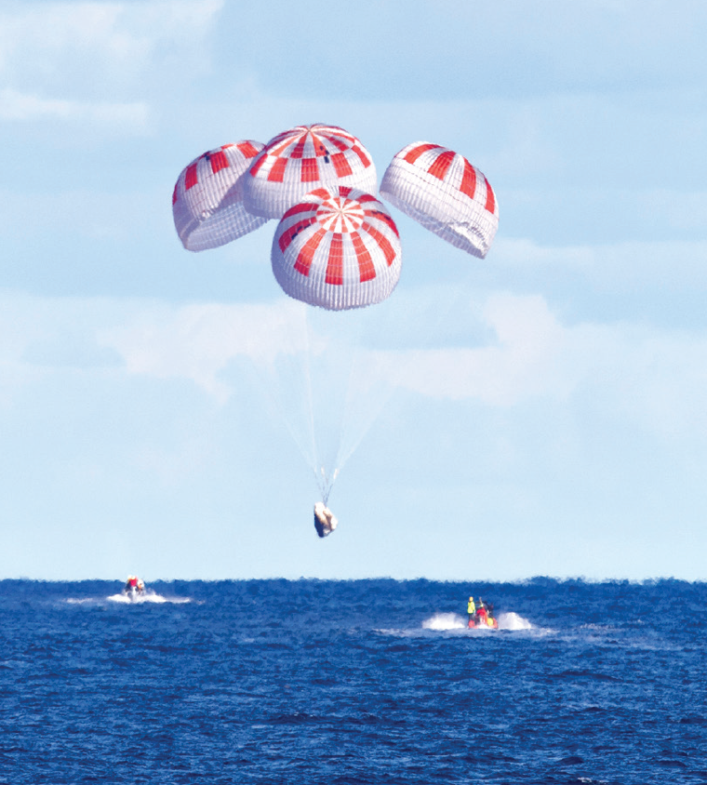
NASA – Space X “Splashdown Sites”
Notes:
Site:
wind_speed < 15 # ft/sec
period_height = wave_period != wave_height
wave_slope < 7 # degrees
rain_prob < 0.25 # % of 25 dBZ
ligthning < 0.25 # % within 10 miles

Slide 3
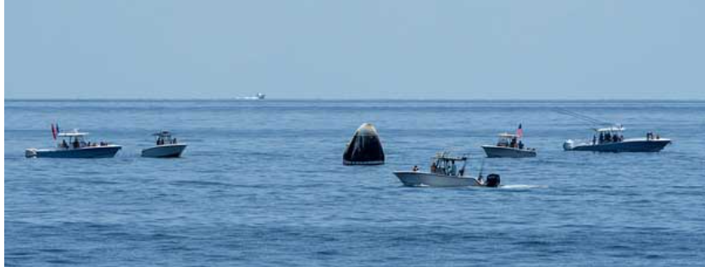
August 2nd, 2020
Notes:
The establishment of an official safety zone that authorizes the Coast Guard to hold legal authority over boaters in violation of entering the area was not available due to the targeted splashdown location being outside of the navigable waterways of the United States, which in most cases is limited to 12-nautical miles from shore.
A Coast Guard 87-foot patrol boat established a physical presence four hours before the scheduled splashdown to discourage boaters from entering within 10-nautical miles of the NASA-designated splashdown zone, for their safety from potential dangers associated with the operation.

Slide 4
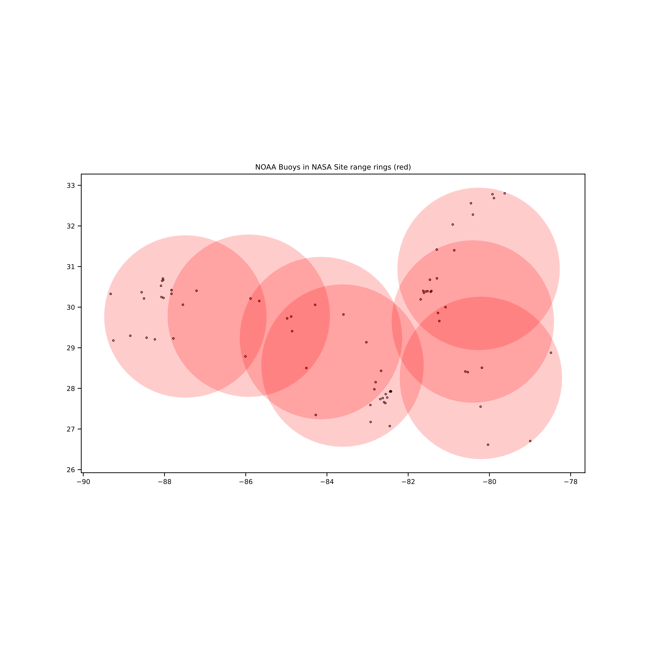
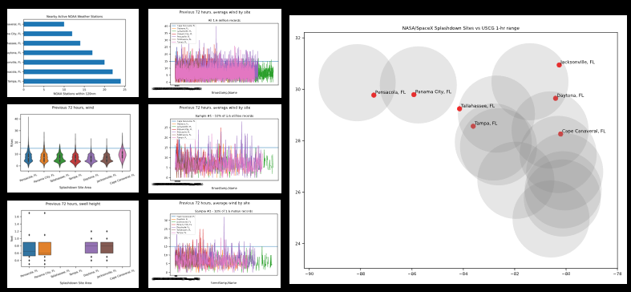
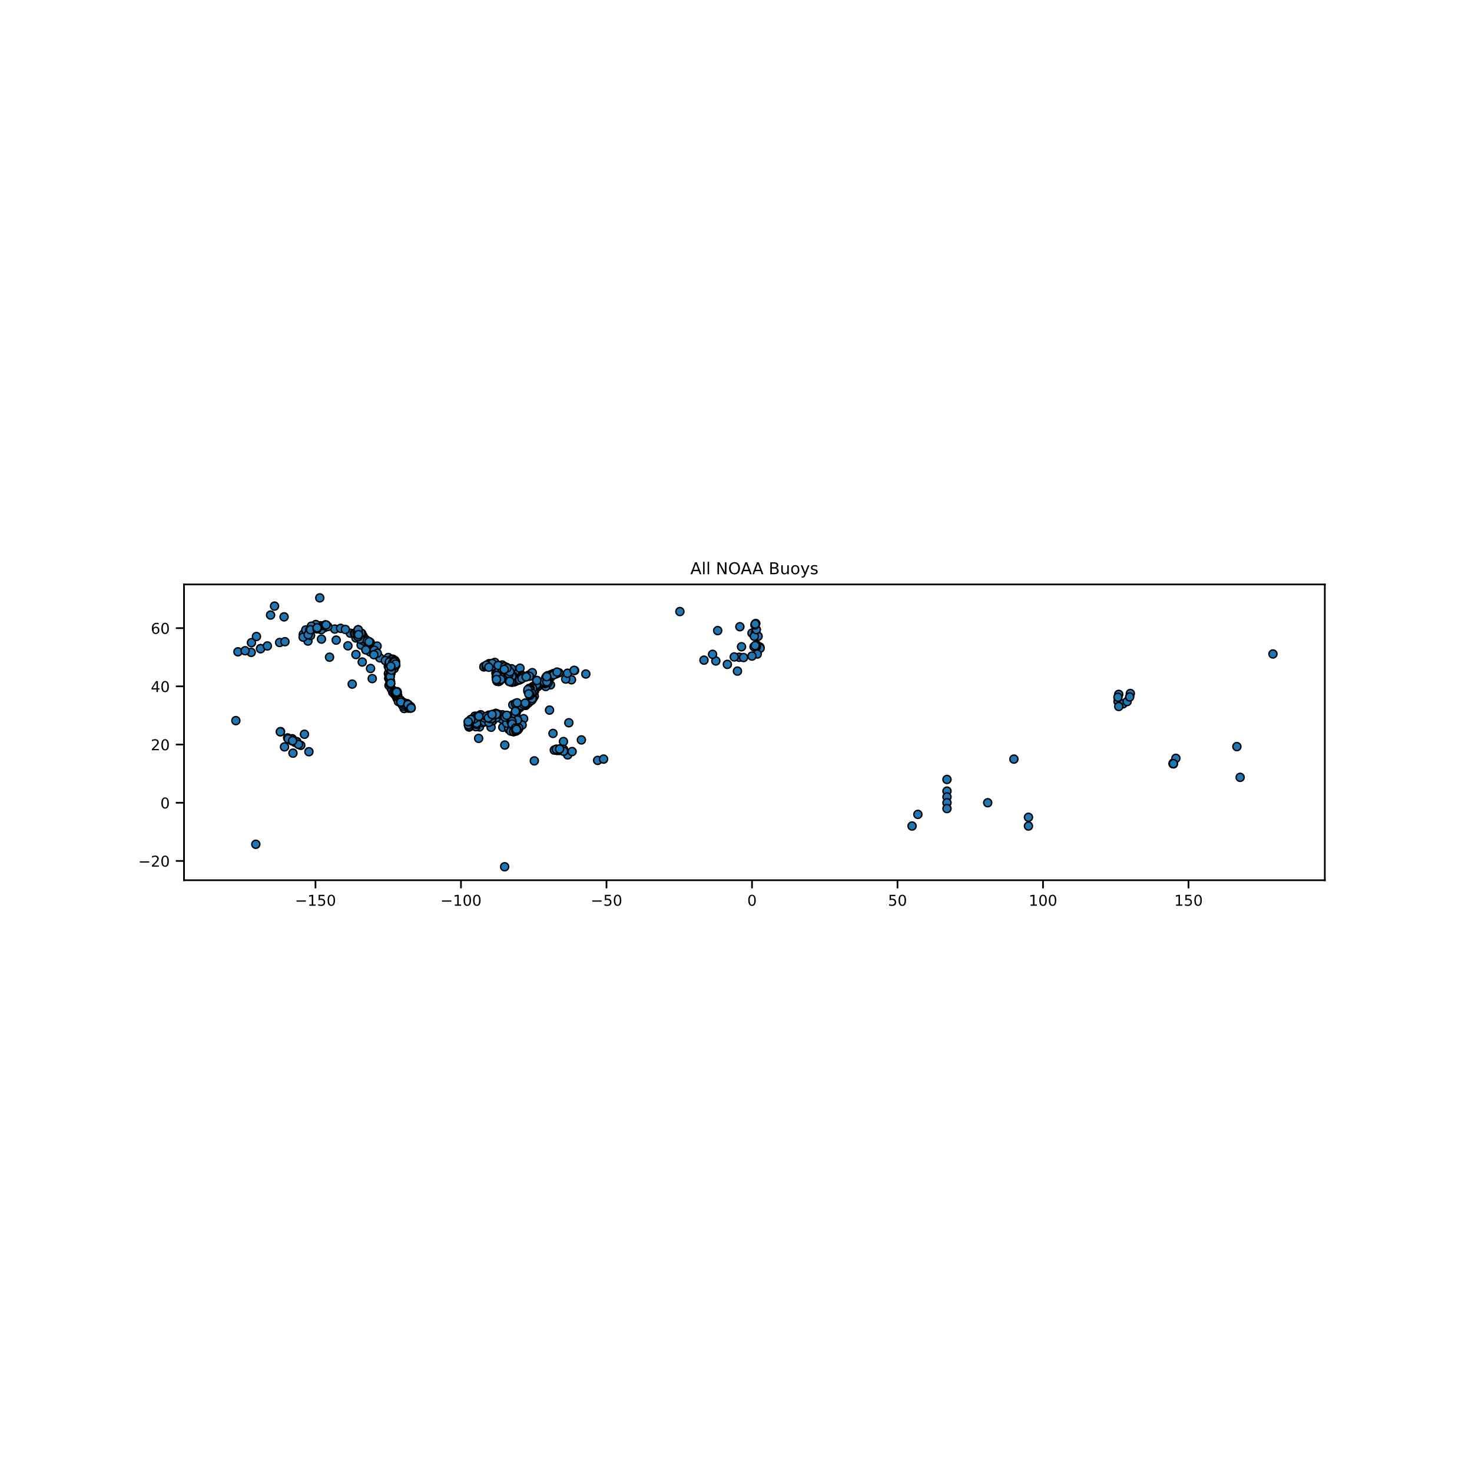
Process
Stage
BATCH DOWNLOAD REAL-TIME DATA
BATCH PROCESS
SELECT PERTINENT DATA
EXPLORE & VALIDATE FINDINGS
glob
wget
glob
geopandas
seaborn
Key Modules
url
File types (.txt)
Folder routing
None*
Site Locations
Site buffer radius
Wind limit
CG units
User Input
Output
List of stations
380 .csv files
Report missing data
Appended file to geopackage
Time (m:ss)
2:14
4:32
0:14
4:36
Notes:
Pandas where used it all stages

Slide 5
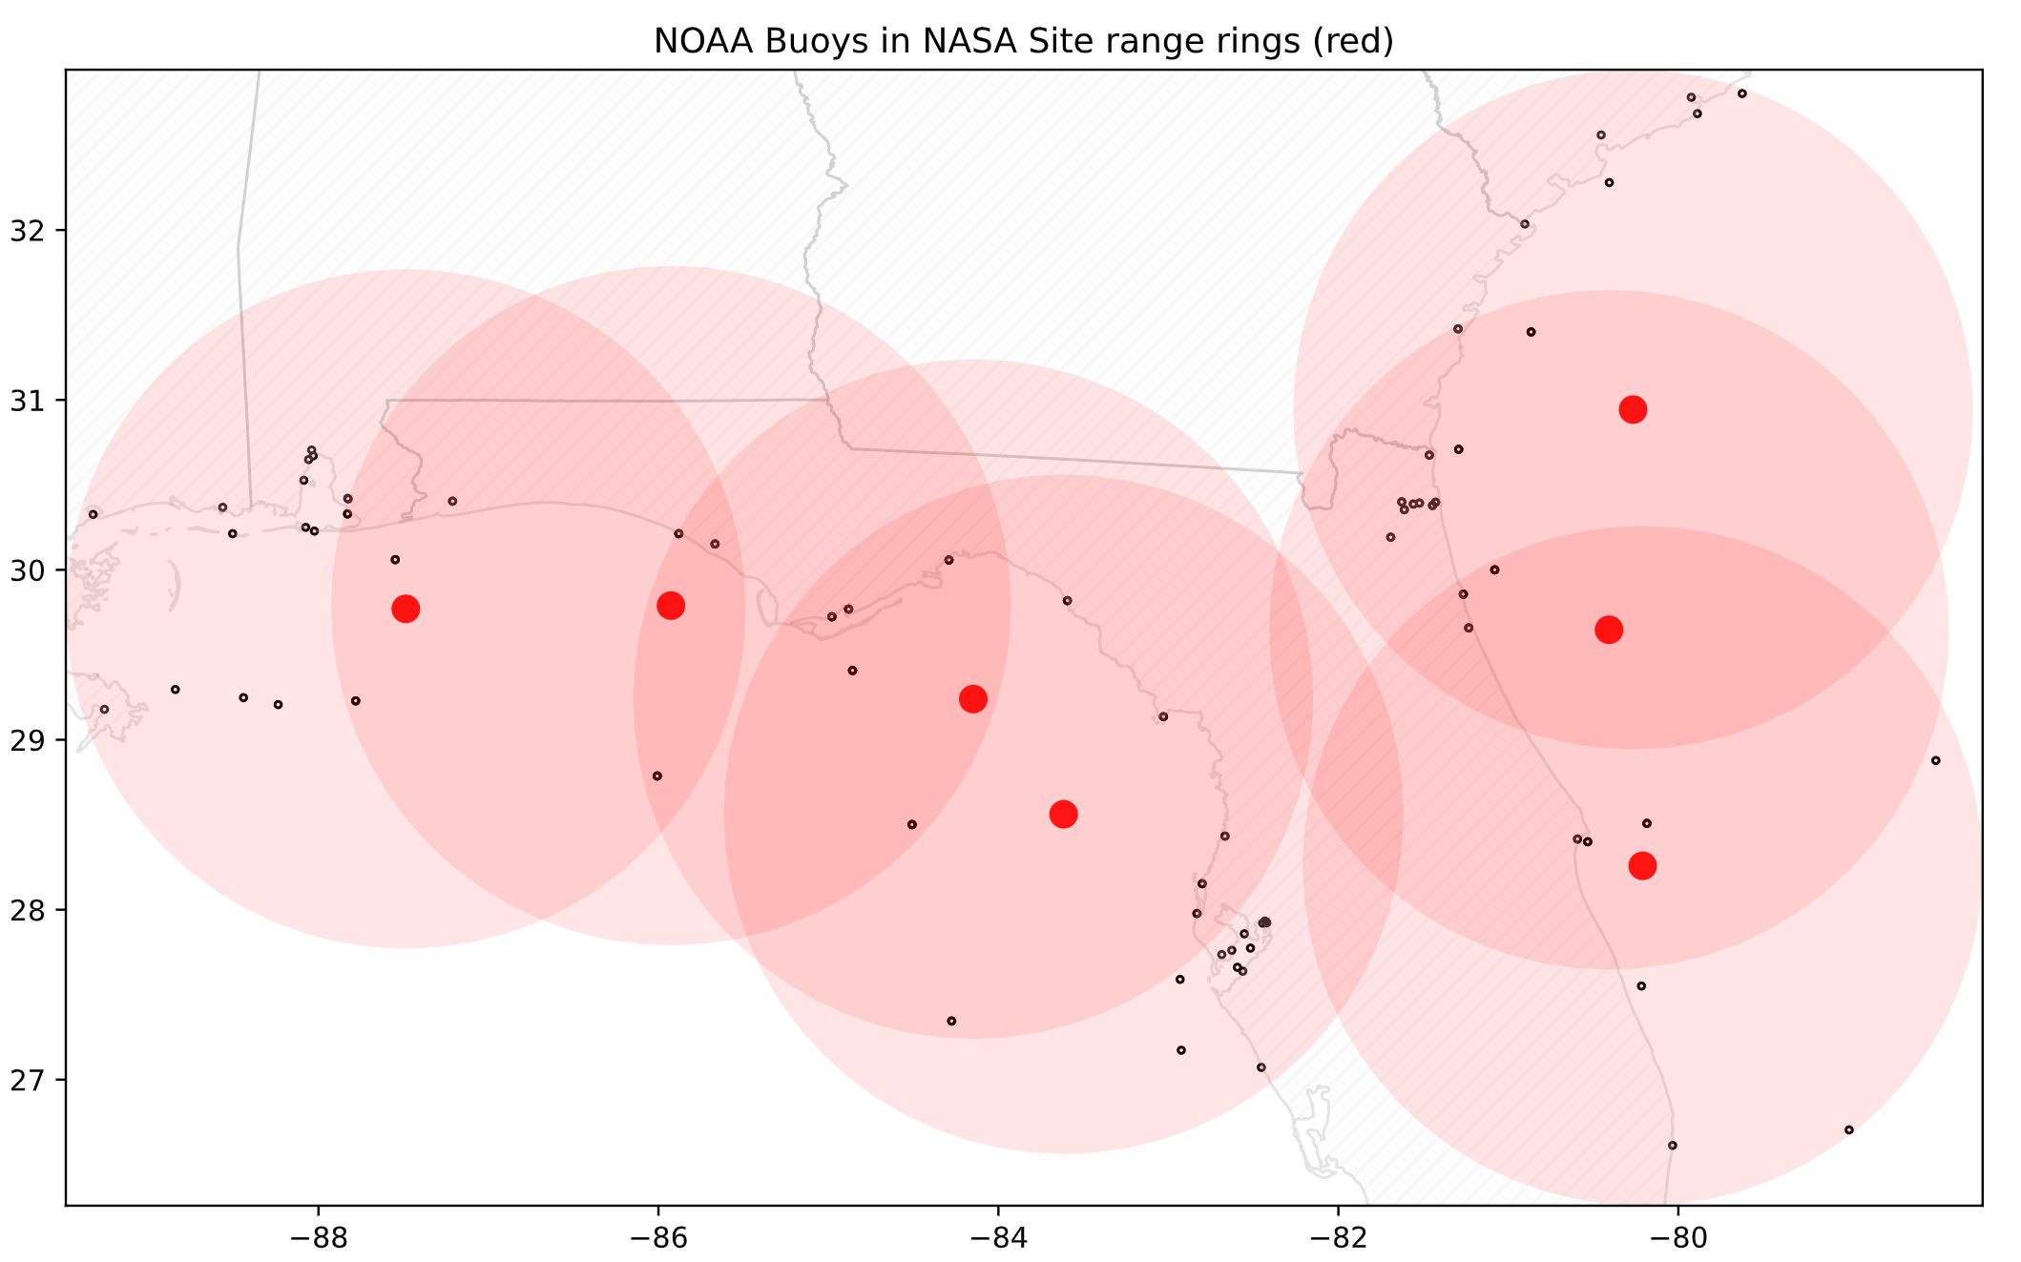
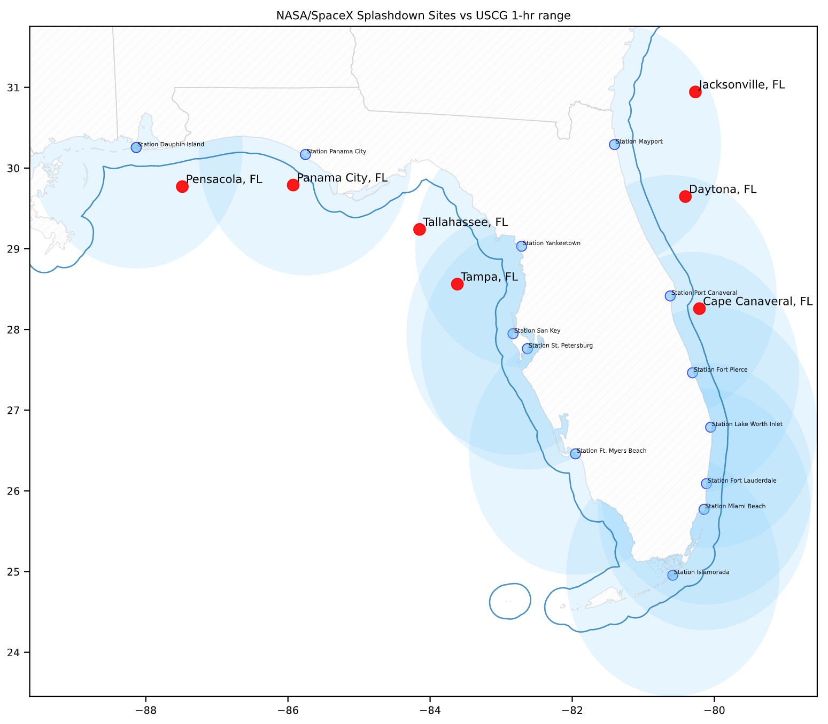
Flow
Data Acquisition & Processing
Analysis Spatial & Temporal
Stage
BATCH DOWNLOAD REAL-TIME DATA
BATCH PROCESS
SELECT PERTINENT DATA
EXPLORE & VALIDATE FINDINGS
glob
wget
glob
os
geopandas
seaborn
Key Modules
url
File types (.txt)
Folder routing
None*
Site Locations
Site buffer radius
Wind limit
CG units
User Input
Output
List of stations
380 .csv files
Report missing data
Appended file to geopackage
Time (m:ss)
2:14
4:32
0:14
4:36
* NOAA columns were renamed for ease.
Note #1: Since it’s a proof of concept, only a 10% sample of the 1.6 million records were used.
Note #2: Other Key Modules include pandas, numpy, matplotlib, csv and urllib.
Notes:
Pandas where used it all stages

Slide 6
Process
Stage
BATCH DOWNLOAD REAL-TIME DATA
BATCH PROCESS
SELECT PERTINENT DATA
EXPLORE & VALIDATE FINDINGS
glob
wget
glob
geopandas
seaborn
Key Modules
url
File types (.txt)
Folder routing
None*
Site Locations
Site buffer radius
Wind limit
CG units
User Input
Output
List of stations
380 .csv files
Report missing data
Appended file to geopackage
Time (m:ss)
2:14
4:32
0:14
4:36
Notes:
Pandas where used it all stages
Durations to complete: 11:38

Slide 7
Process
Stage
BATCH DOWNLOAD REAL-TIME DATA
BATCH PROCESS
EXPLORE & VALIDATE FINDINGS
glob
wget
glob
geopandas
seaborn
Key Modules
url
File types (.txt)
Folder routing
None*
Site Locations
Site buffer radius
Wind limit
CG units
User Input
Output
List of stations
380 .csv files
Report missing data
Appended file to geopackage
Time (m:ss)
2:14
4:32
0:14
4:36
Notes:
Pandas where used it all stages

Slide 8
801 stations
(1.6 million observations in 72 hours)
119 stations
(237k observations in 72 hours)

Slide 9
Process
Stage
BATCH DOWNLOAD REAL-TIME DATA
BATCH PROCESS
SELECT PERTINENT DATA
EXPLORE & VALIDATE FINDINGS
glob
wget
glob
geopandas
seaborn
Key Modules
url
File types (.txt)
Folder routing
None*
Site Locations
Site buffer radius
Weather limits
CG units
User Input
Output
List of stations
380 .csv files
Report missing data
Appended file to geopackage
Time (m:ss)
2:14
4:32
0:14
4:36
11:38
Notes:
Pandas where used it all stages
Durations to complete: 11:38

Slide 10
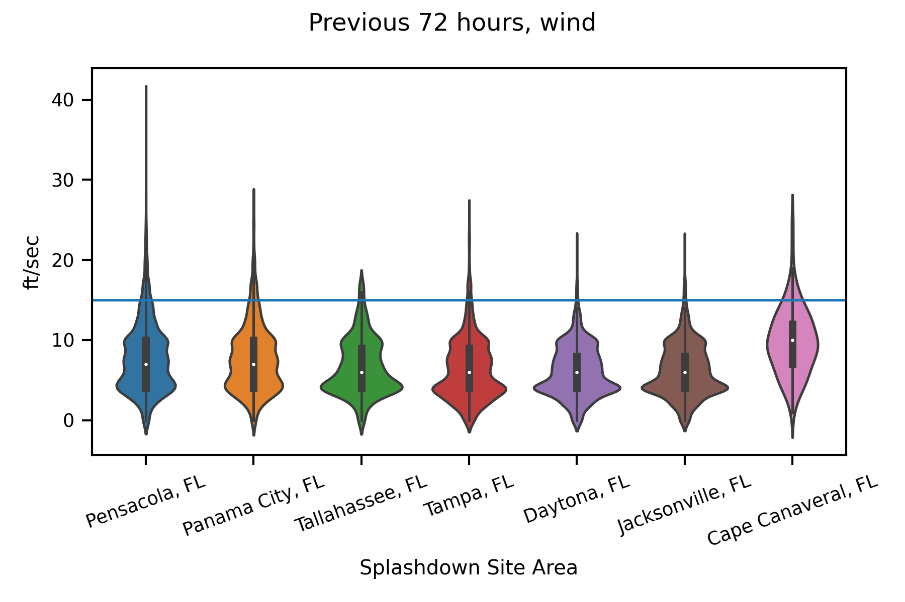
Notes:
5 ft/sec = 3.4 mph

Slide 11
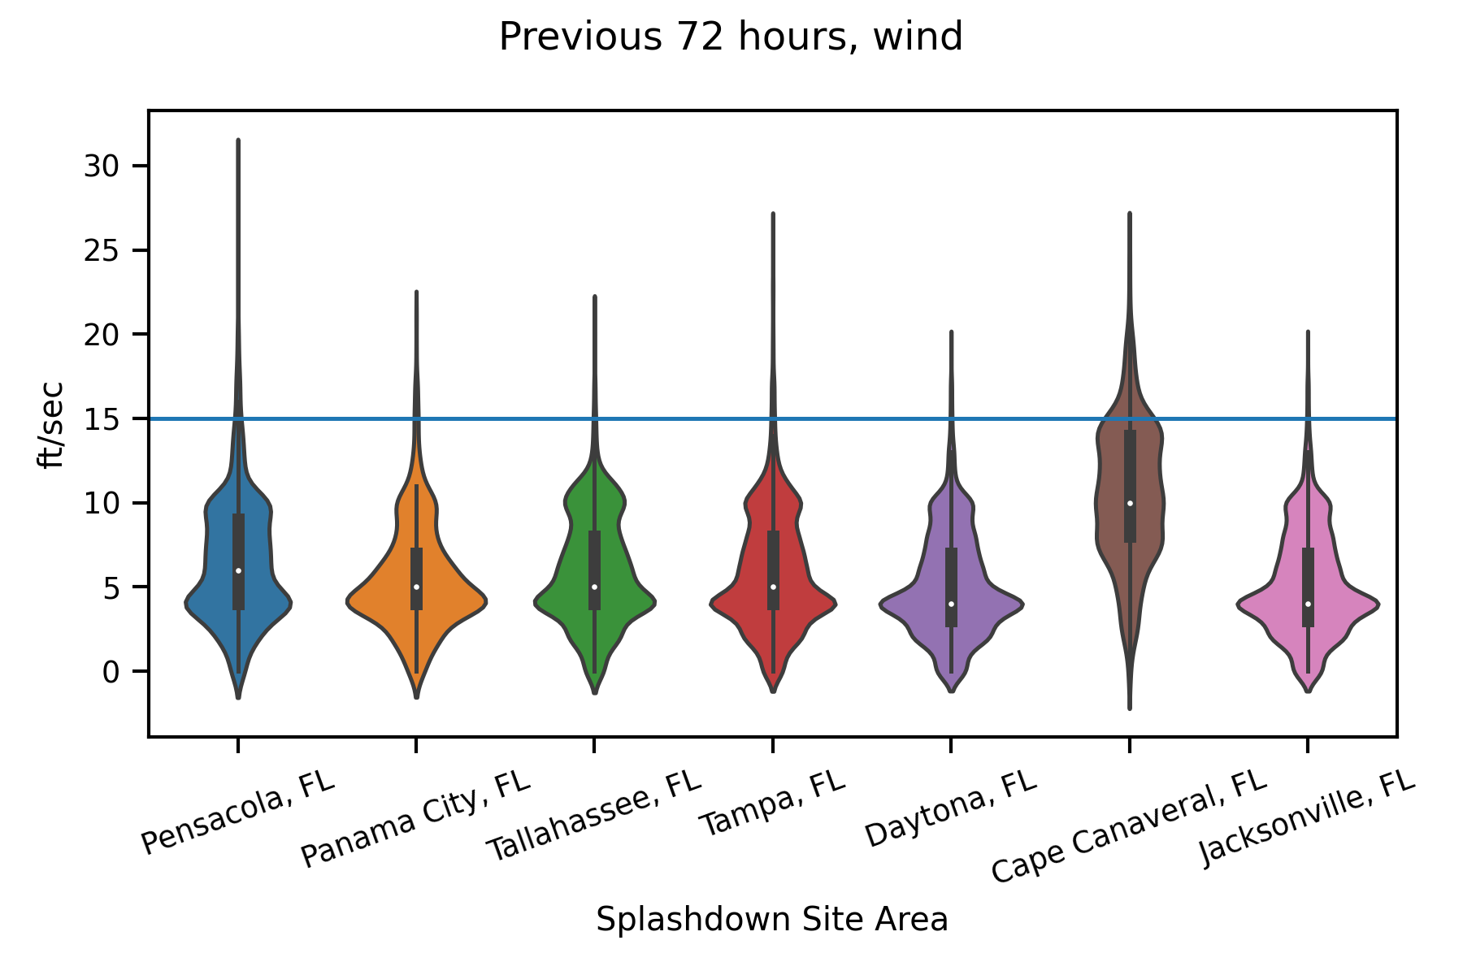
5/10/21
5/12/21

Slide 12
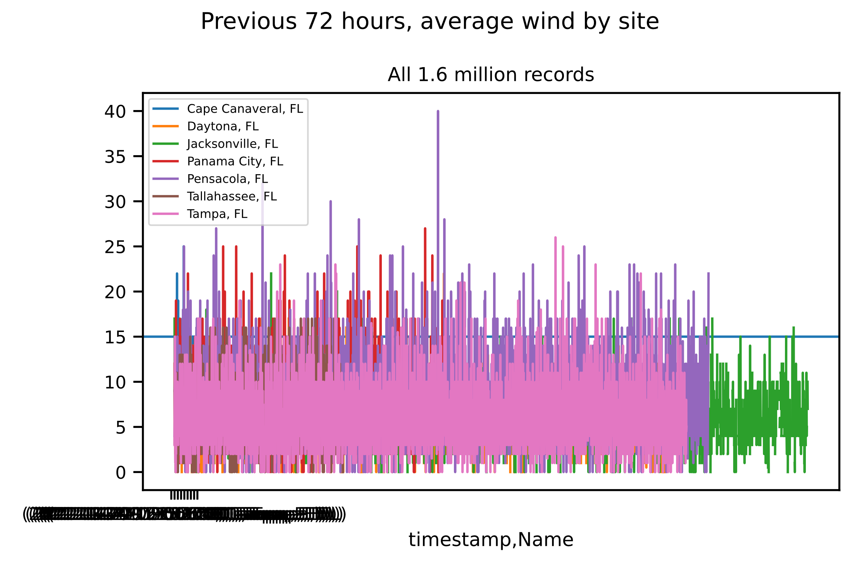

Slide 13
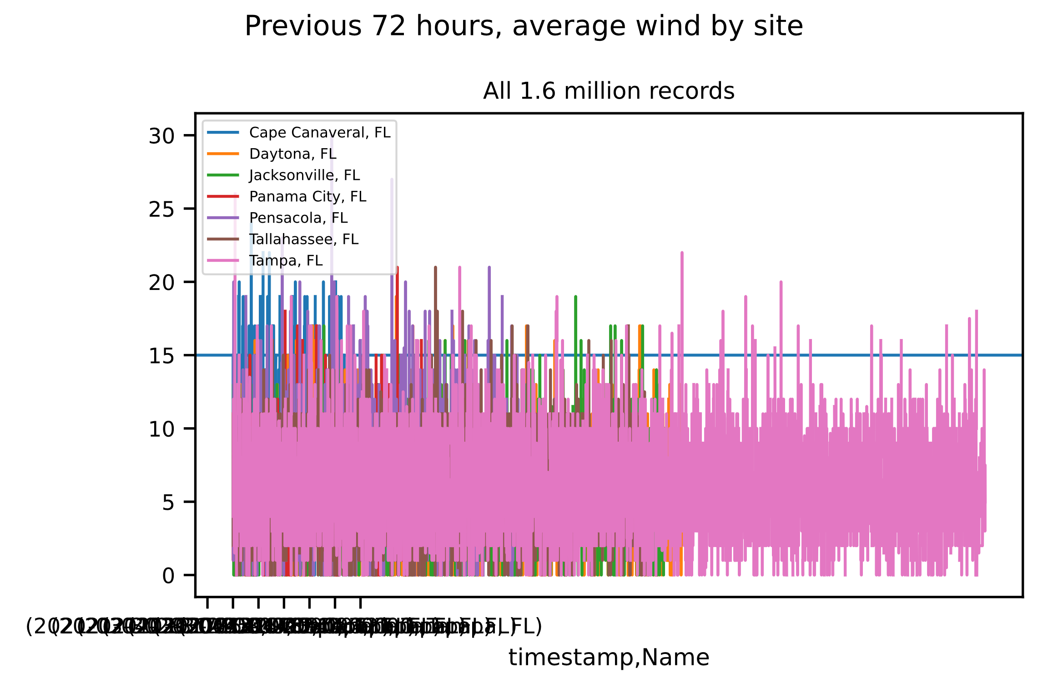
5/10/21
5/12/21
Notes:
Green = Jacksonville
Pink = Tampa

Slide 15
Space X Splashdown Site – Evaluation (real-time weather updates)

Slide 16
